Slide 1
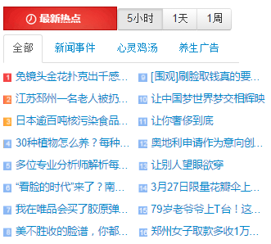
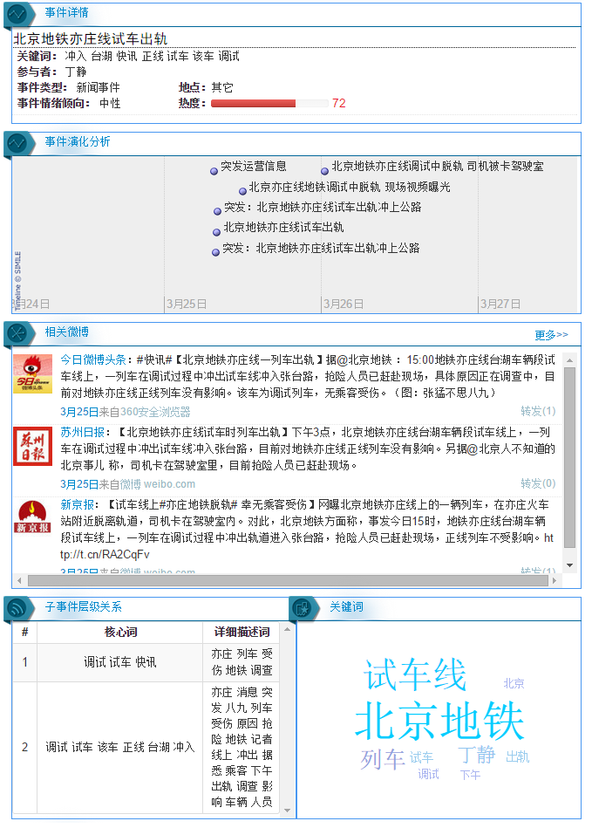
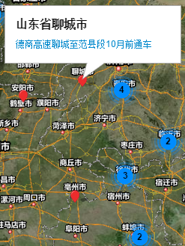
Trending events
Event analysis
5 hrs 1 day 1 week
Essential Context: Keywords, Participants, Class, Sentiment, Location, Popularity
Event tracing
Test train of Beijing subway system ran off rail and the driver is locked in the carriage
Emergency Event: Test train of Beijing subway system ran off rail onto a highway.
Events’ geographical distribution
Related microblogs
Liaocheng City, Shandong
A highway will open before October.
Subevent hierarchy
Keyword cloud
Trending Keywords
Debug, Test Run,
Breaking news
Debug, Test Run, Train,
Railroad, Tai Hu, Ran off
Beijing Subway, Test Run Line, Train etc...

